Slide 1
ReGENerATIVE tourism
Lecture 11

Slide 2

Is it just sustainable tourism rebranded?

Slide 3
Regenerative approaches
Use systems thinking; we are all part of a whole, and the whole receives the benefits of our actions.
Foster connections and relationships
Are based on an “ethics of care”
Are able to identify and foster reinforcing positive feedback loops and/or reverse reinforcing negative feedback loops.
use some of the higher order leverage points described by Meadows – particularly the changing paradigms one.

Slide 4
A definition
“Regenerative tourism is bolder and more inspiring. It aims not just to do less harm, but to go on and restore the harm that our system has already done to the natural world, and by using nature’s principles, to create the conditions of life to flourish. It views wholes and not parts, and is a very different way of looking at the world.”
Anna Pollock, 2019.

Slide 5
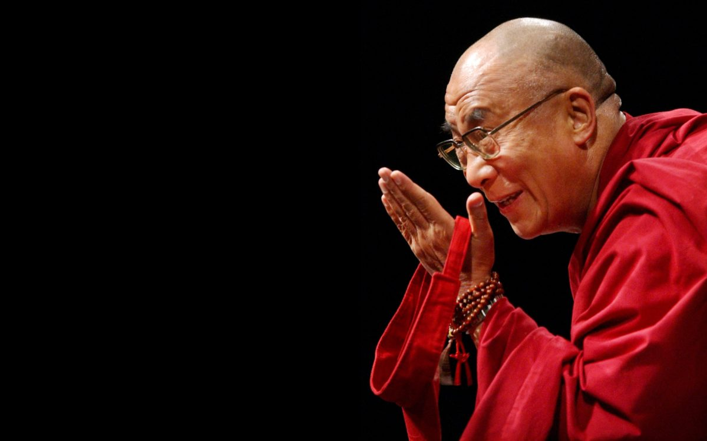
Switching mindsets around success…
The Planet does not need more successful people. The planet desperately needs more peacemakers, healers, restorers, storytellers and lovers of all kinds.

Slide 6
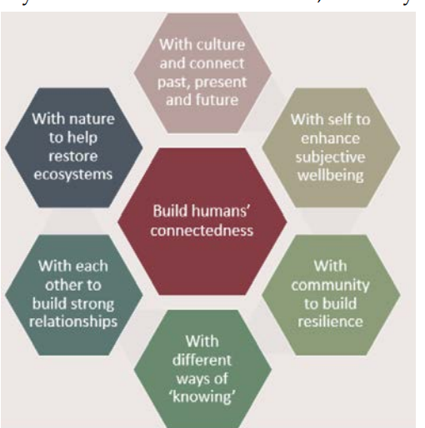
A focus on connected-ness
And perhaps also on service and healing?

Slide 7
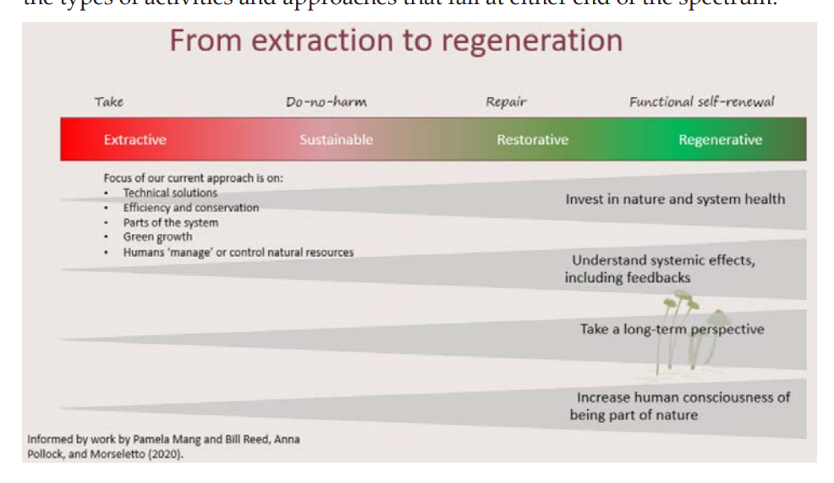

Slide 8
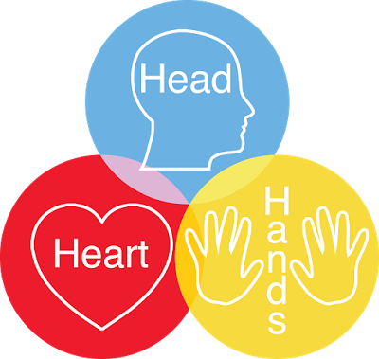

Slide 9
Becken and Kaur,2021
Place-based: decision-making is collaborative and recognises place
Humans in nature, not apart
Innovative, adaptive and responsive: alternative economic models with the ability to adapt to change and the dynamics of living systems become the norm.
Multiple wellbeings: a balance is sought across various forms of wealth and benefits are distributed fairly.
Holistic: the health of all systems depend upon each other and the health of the natural system.
Biomimicry: principles such as redundancy, abundance, regulating feedback loops should be learned from nature in order to collaborate with her.
Distributed and networked: participation involving all parts of the larger whole in ways that empower people. Everyone provides their unique contribution towards system health.
Trans-disciplinary: knowledge comes in many forms, including Western Science, indigenous and practical knowledge.

Slide 10
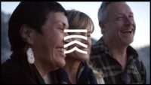
Examples (note it’s a way of thinking and doing, not just doing):

Slide 11
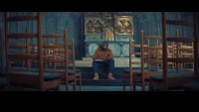

Slide 12
Requires an open-mindedness
Explore ideas that fall outside the mainstream, e.g.
  Susanne Simard’s Mother Trees
  Don Hoffman’s “through the headset”
  Indigenous knowledge systems
  Decolonial thinking
  Jung’s collective consciousness
  Etc.

Slide 13
Next up
Course review

